Slide 1
Taobao User Behavior Analysis
Tianyao Sun, Youqing Liang, Zunduo Zhao

Slide 2
Motivation
User of this analysis:
The online shopping platform.
Who will benefit from this analytic:
Both the user and the platform.
Why is important:
This analysis provides insights of people’s online shopping behavior pattern and is essential for improving user experience of these online shopping platforms.

Slide 3
Goodness
The hypothesis are made out of our rich experience in using this app.
The statistical results are validated across different data sources.
Provide the data points to improve the recommendation algo’s Ads relevance

Slide 4
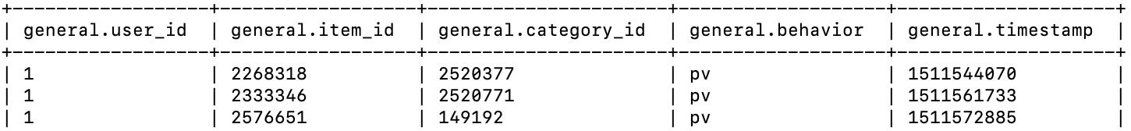
Data Sample
Data source 1: User Behavior Data from Taobao for Recommendation
Size: 3.6 GB csv file
5 columns: user_id, item_id, category_id, behavior_type, time_stamp
162,024 of items, 9,439 of categories and 100,150,807 of interactions
User behavior type: buy, cart (add an item to shopping cart), fav (add an item to favorite), pv (view item page)

Slide 5
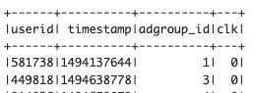
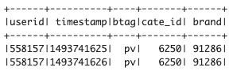
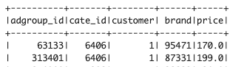
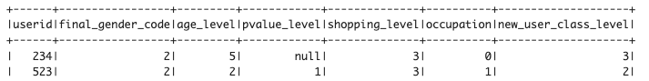
Data Sample
Data source 2: Ad Display/Click Data on Taobao.com
ad_feature
raw_sample
behavior_log
user_profile

Slide 6
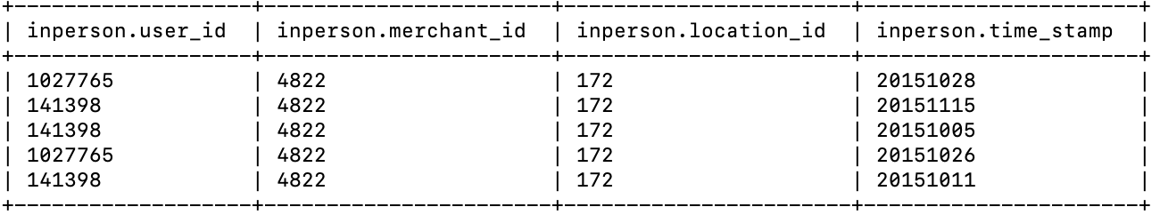
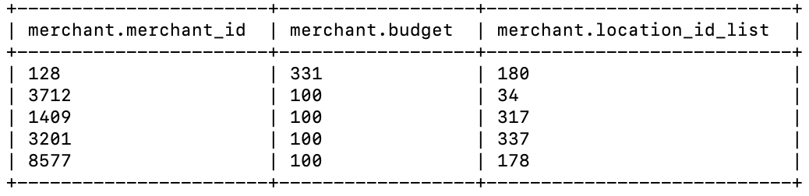
Data Sample
Data Source 3: Brick-and-Mortar Store Recommendation Dataset
Table 1: Users’ shopping records at brick-and-mortar stores Table 2: Merchant Information
Table 3: Online user behavior before Dec. 2015.

Slide 7
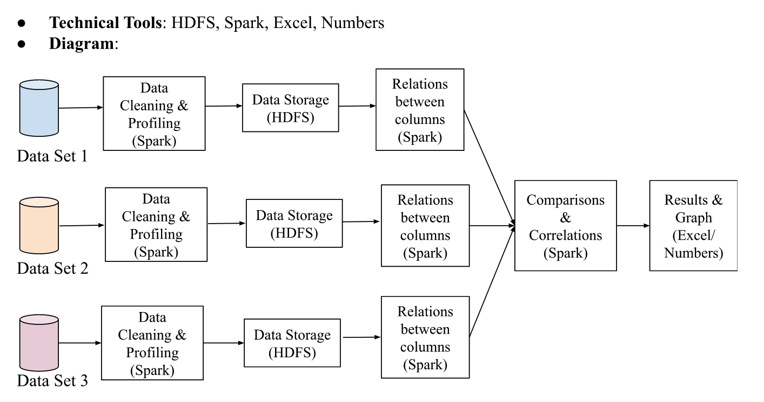
Design Diagram

Slide 8
Code challenge
Complex Spark SQL query and dataFrame structure transformation
Debugging difficulty on spark exceptions handling

Slide 9
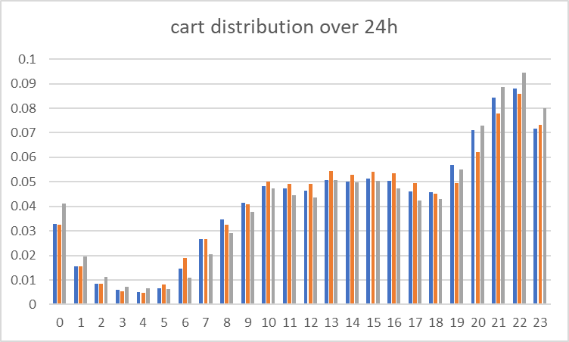
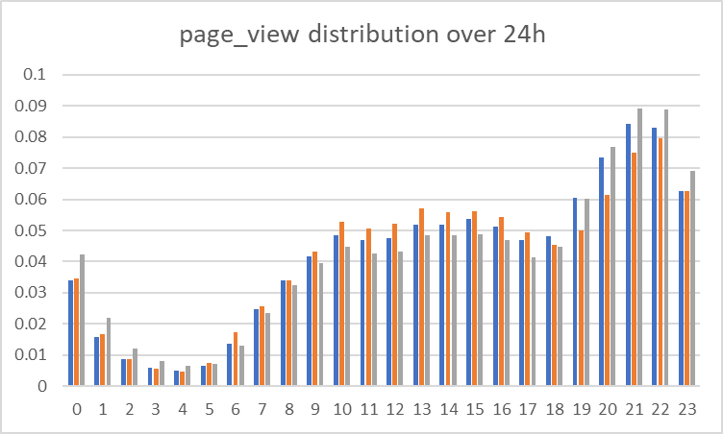
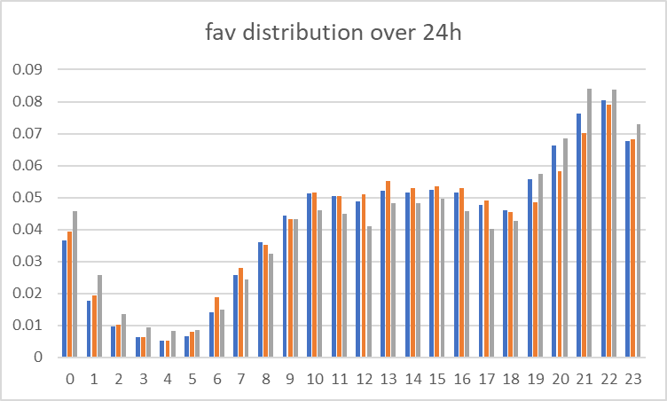
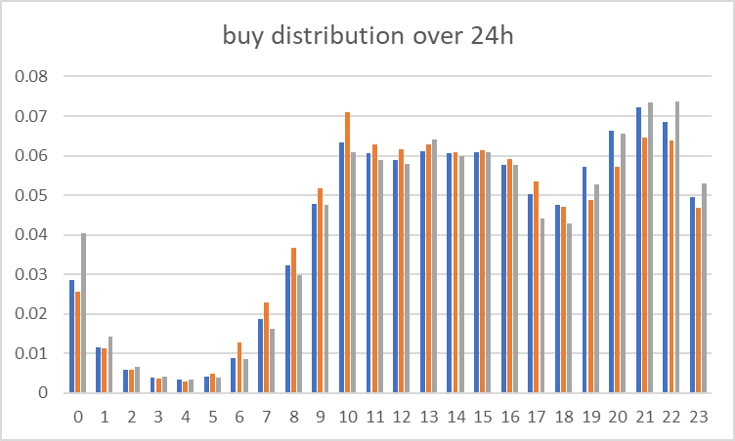
Result (behavior distributions)

Slide 10
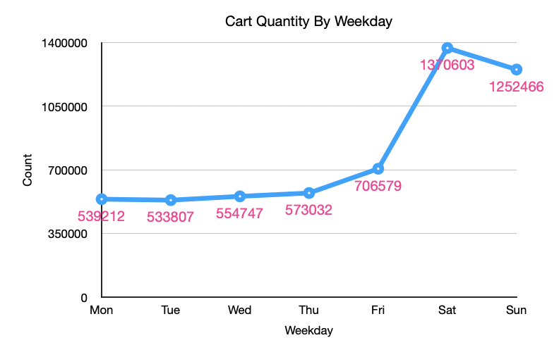
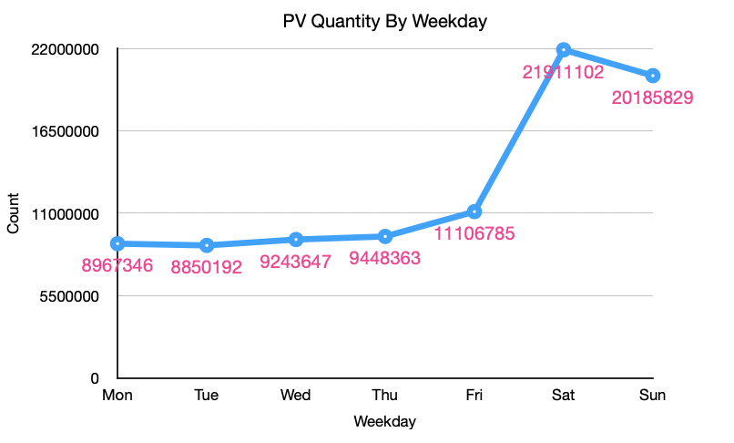
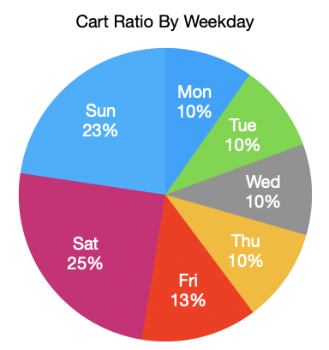
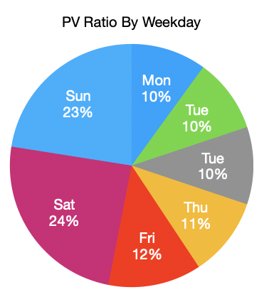
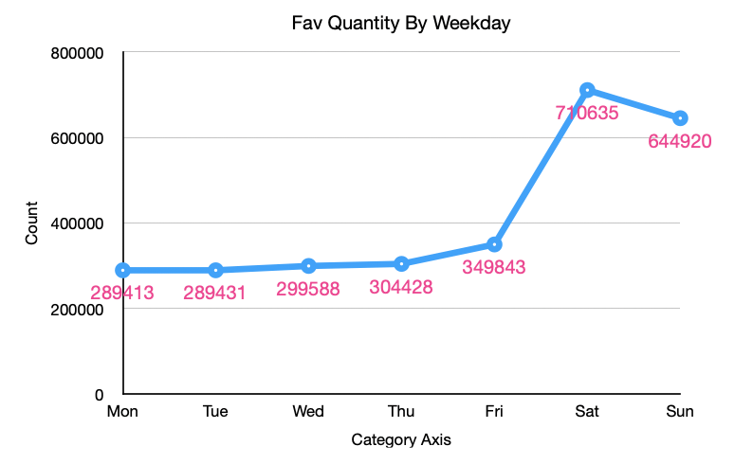
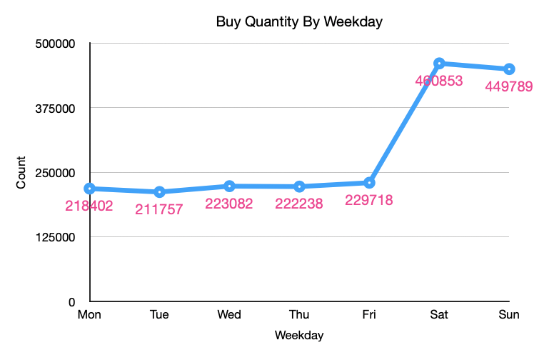
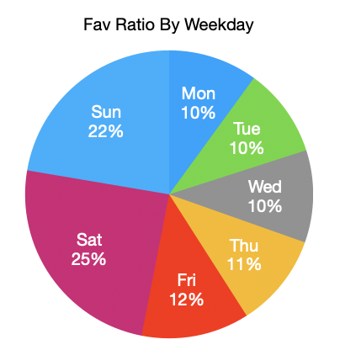
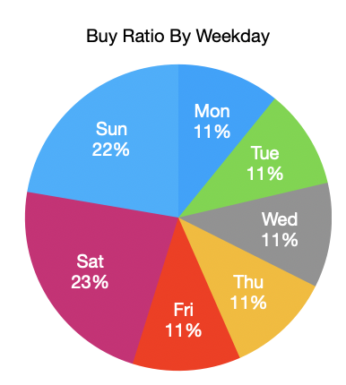
Behavior Type Occurrence By Weekday

Slide 11
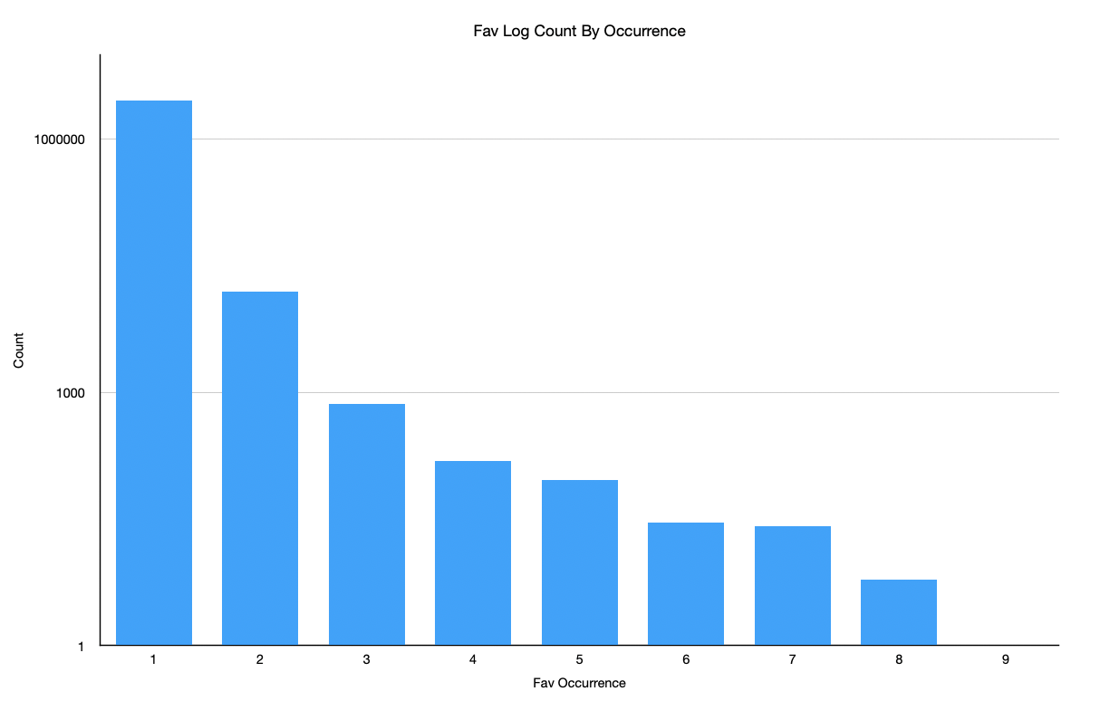
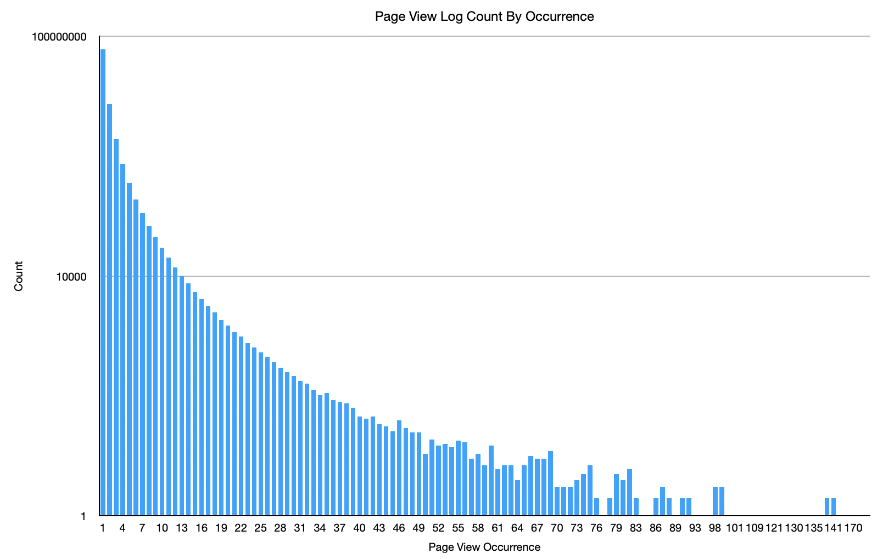
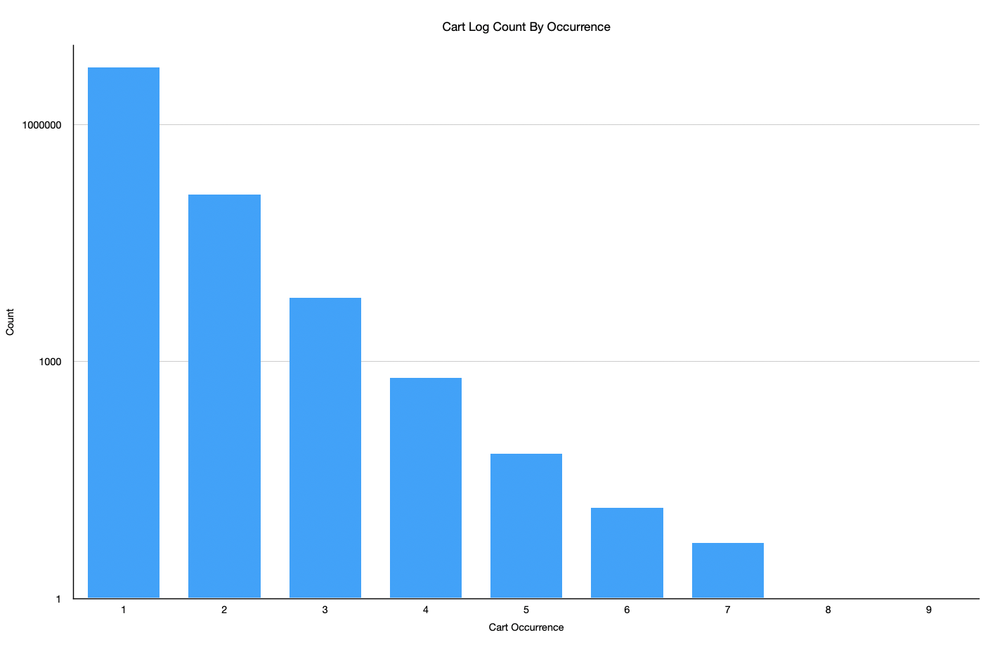
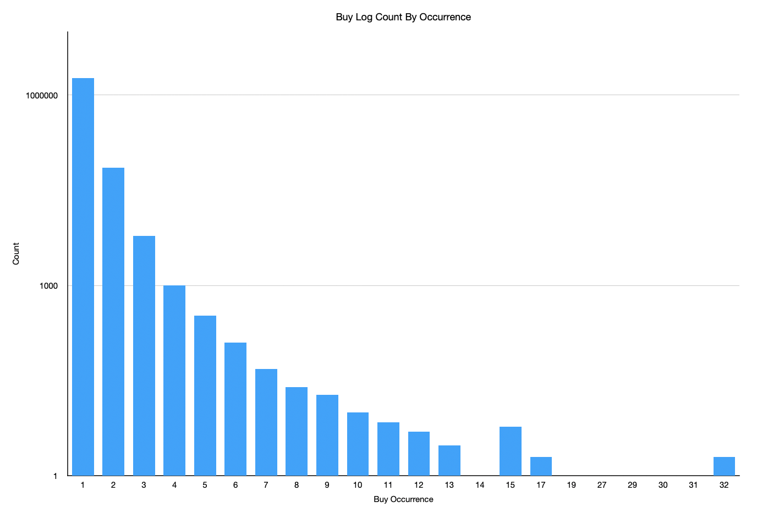
Behavior Occurrence

Slide 12
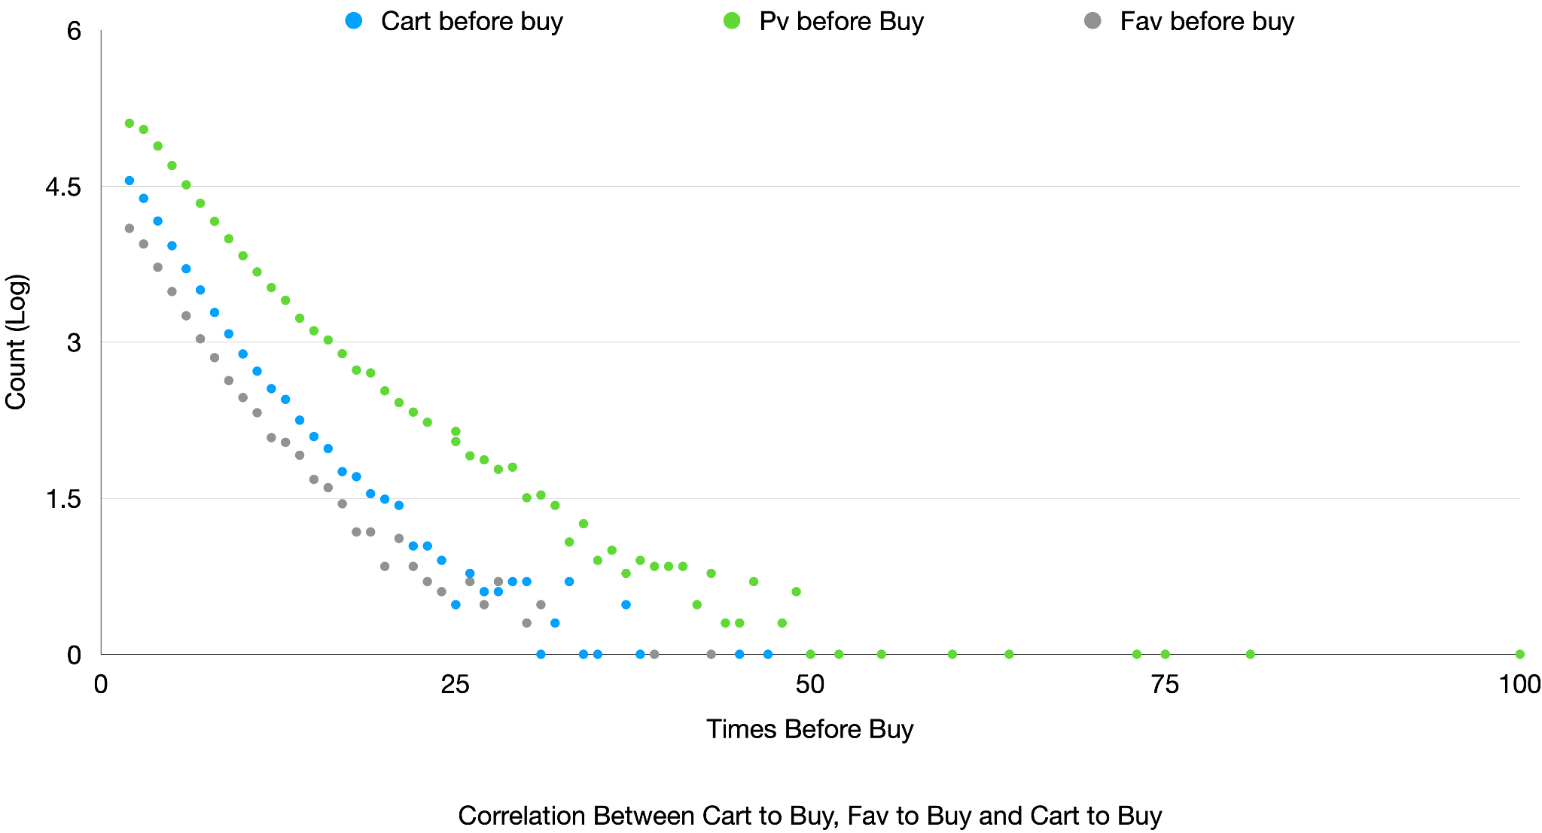
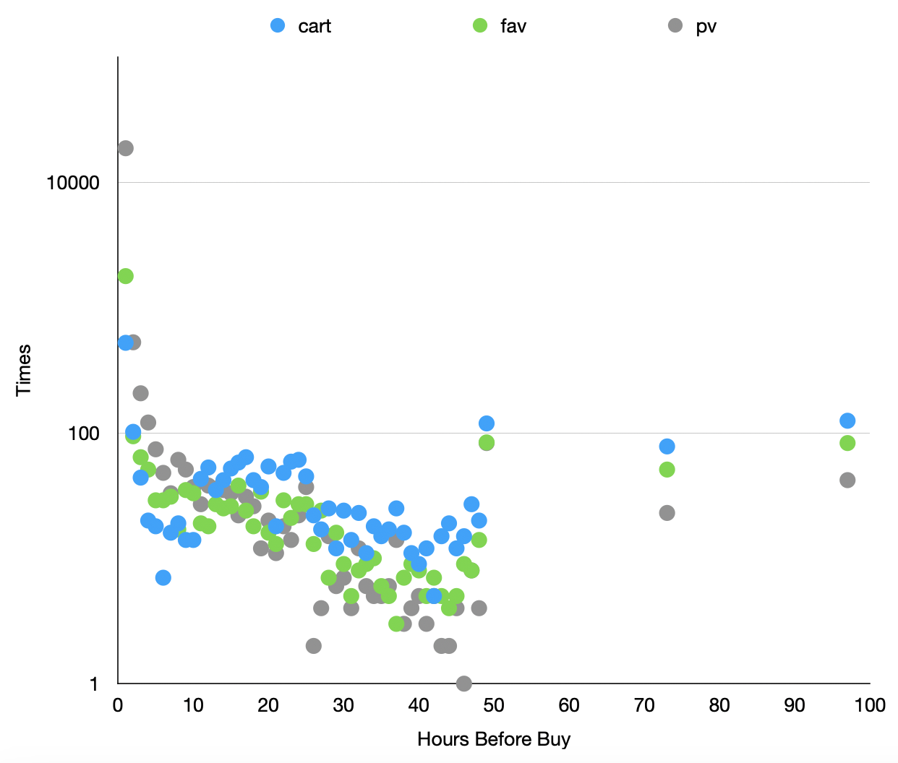
Result (correlation of cart, fav, pv to buy)

Slide 13
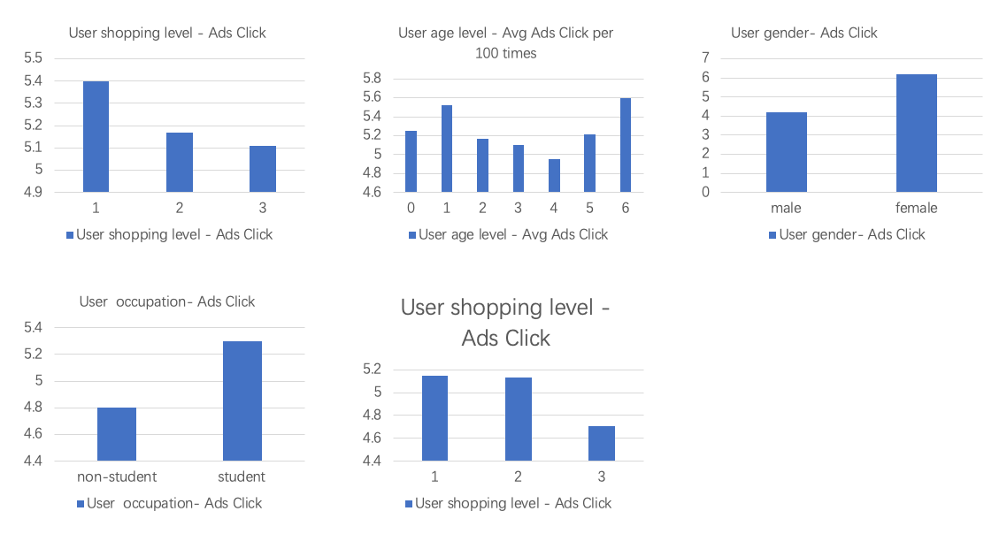
Result (Average num of ads clicked by user per 100 times)

Slide 14
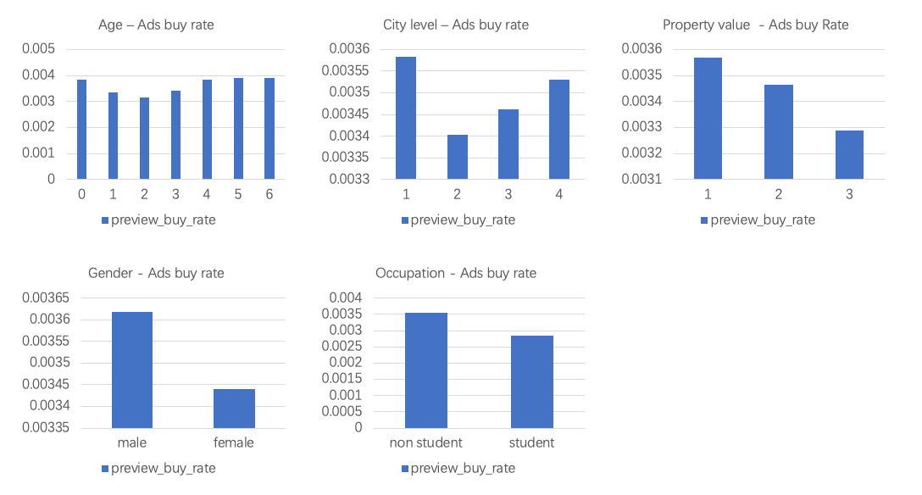
Result (Purchase rate after user click the Ads)

Slide 15
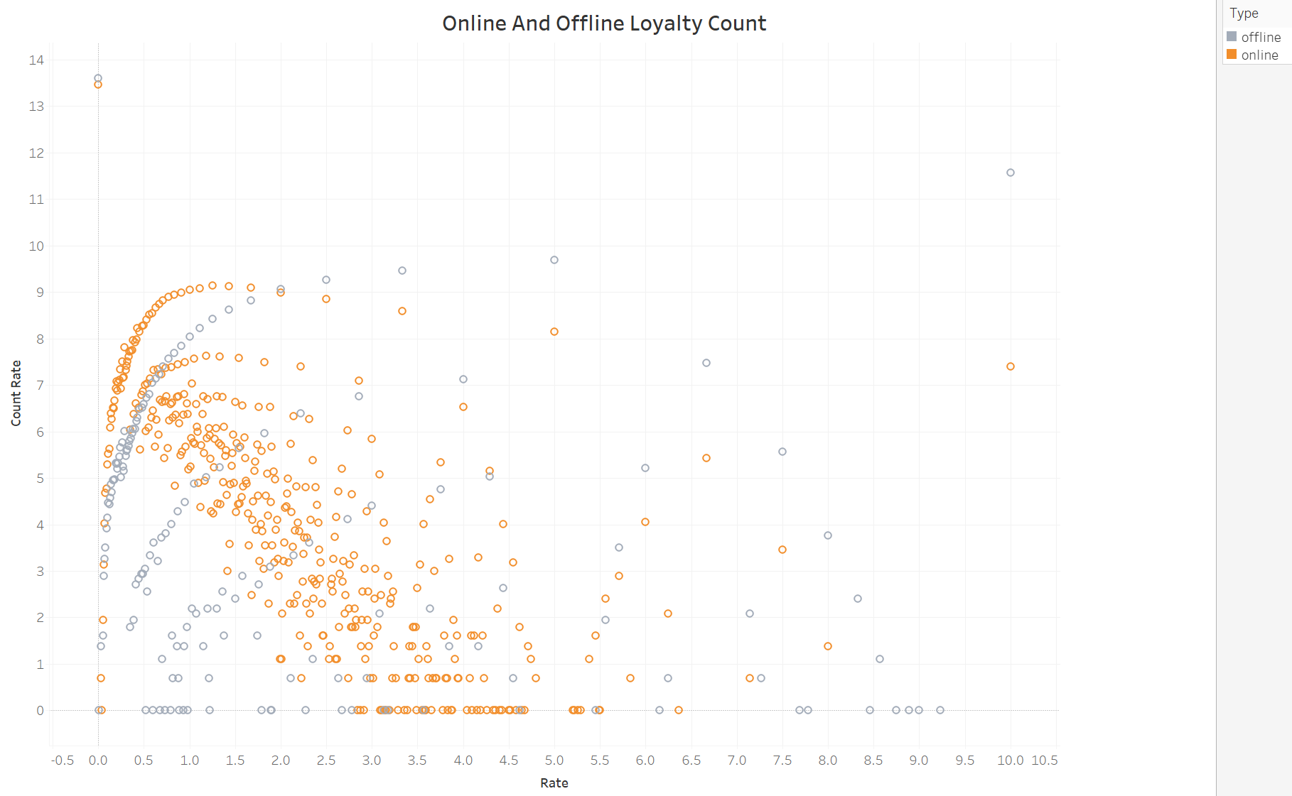
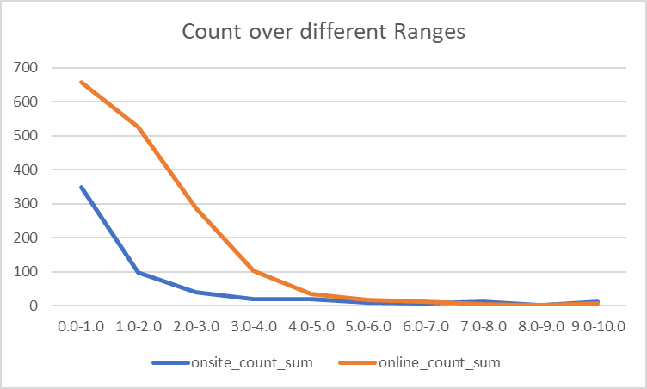
Result (Online vs Offline Loyalty Count)

Slide 16
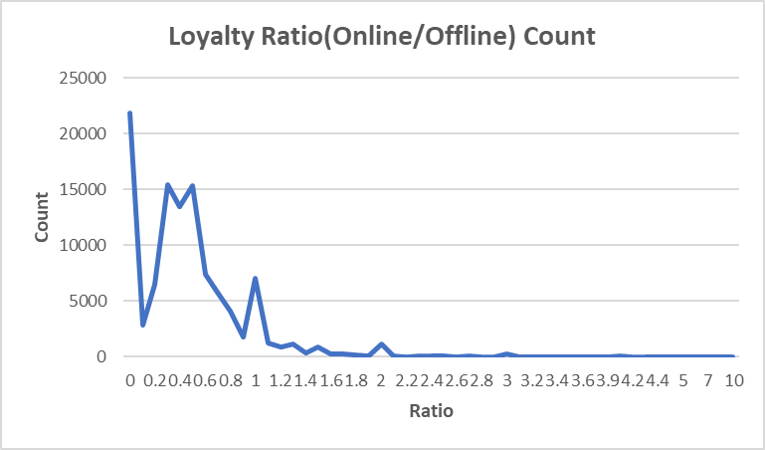
Result (Loyalty Ratio Count)

Slide 17
Obstacles
Unable to provide comprehensive analysis due to the masked data
Limited time span of the data sources
Restricted computation ability on Peel cluster (Zeppelin)

Slide 18
Summary
The project analyzed the user behavior pattern on Taobao.
Investigate the customer's consumption habits with multiple factors(offline - online shopping, Ads effects on multiple consumer's background, shopping behavior Type Occurrence By Weekday)
This work can provide useful insights on how to build more personalized recommendation systems.

Slide 19
Acknowledgements
The open source data platform – Tianchi
Taobao
Professor Yang Tang
NYU High Performance Computing
Google Cloud Dataproc

Slide 20
Thank you!

